Slide 1
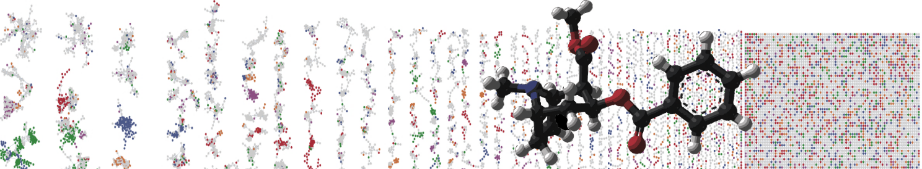


Chemical Directionality in Molecular Networks
(ChemDir)
Mauricio Caraballo, Ming Wang and Daniel Petras
University of California - San Diego
Slides by
Daniel Petras & Mauricio Caraballo

Slide 2

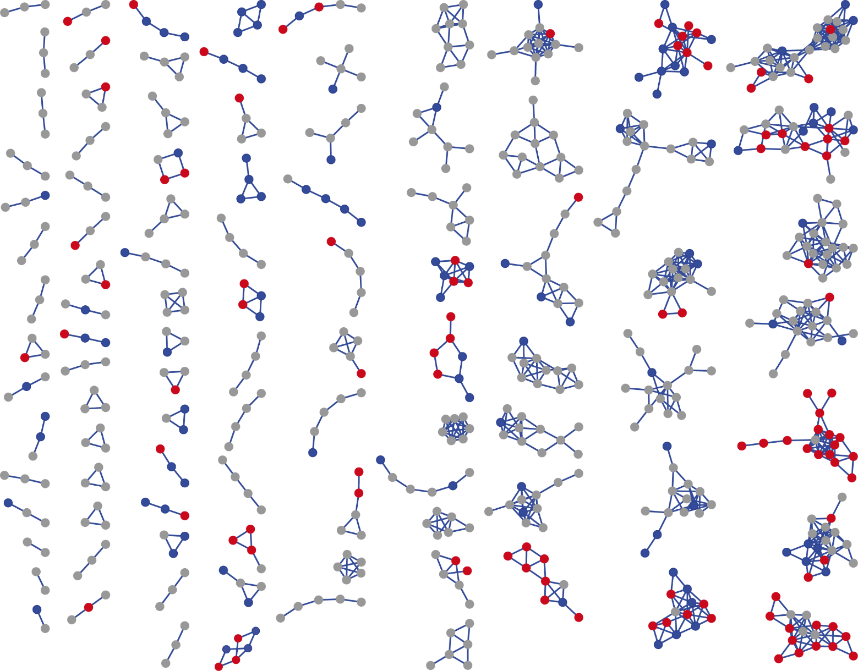
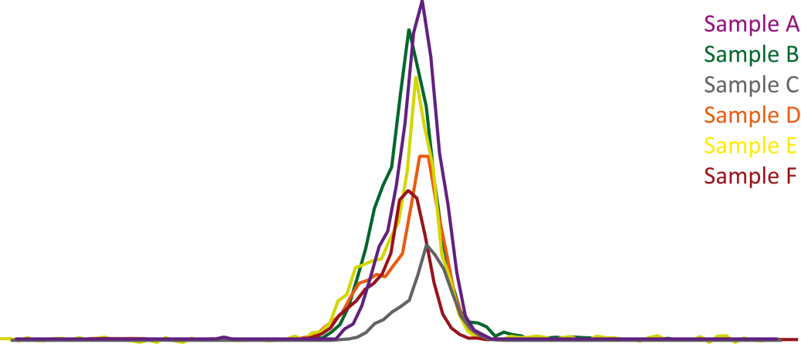
Feature-Based Molecular Networking (FBMN)
Polyketides
1
Library Hit A
Library Hit B
Lipids
2
Peptides
3
Amino acids
Nothias, Petras, Schmid, et al. bioRxiv, 2019

Slide 3
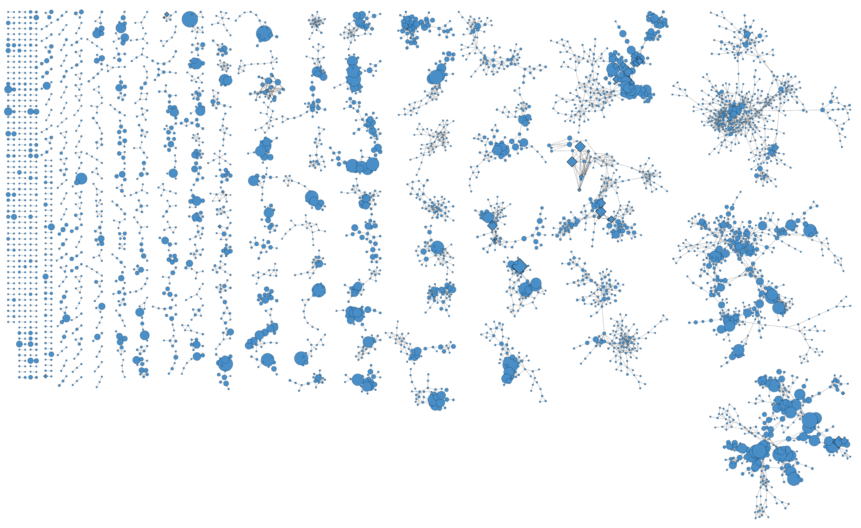
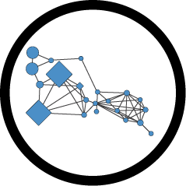
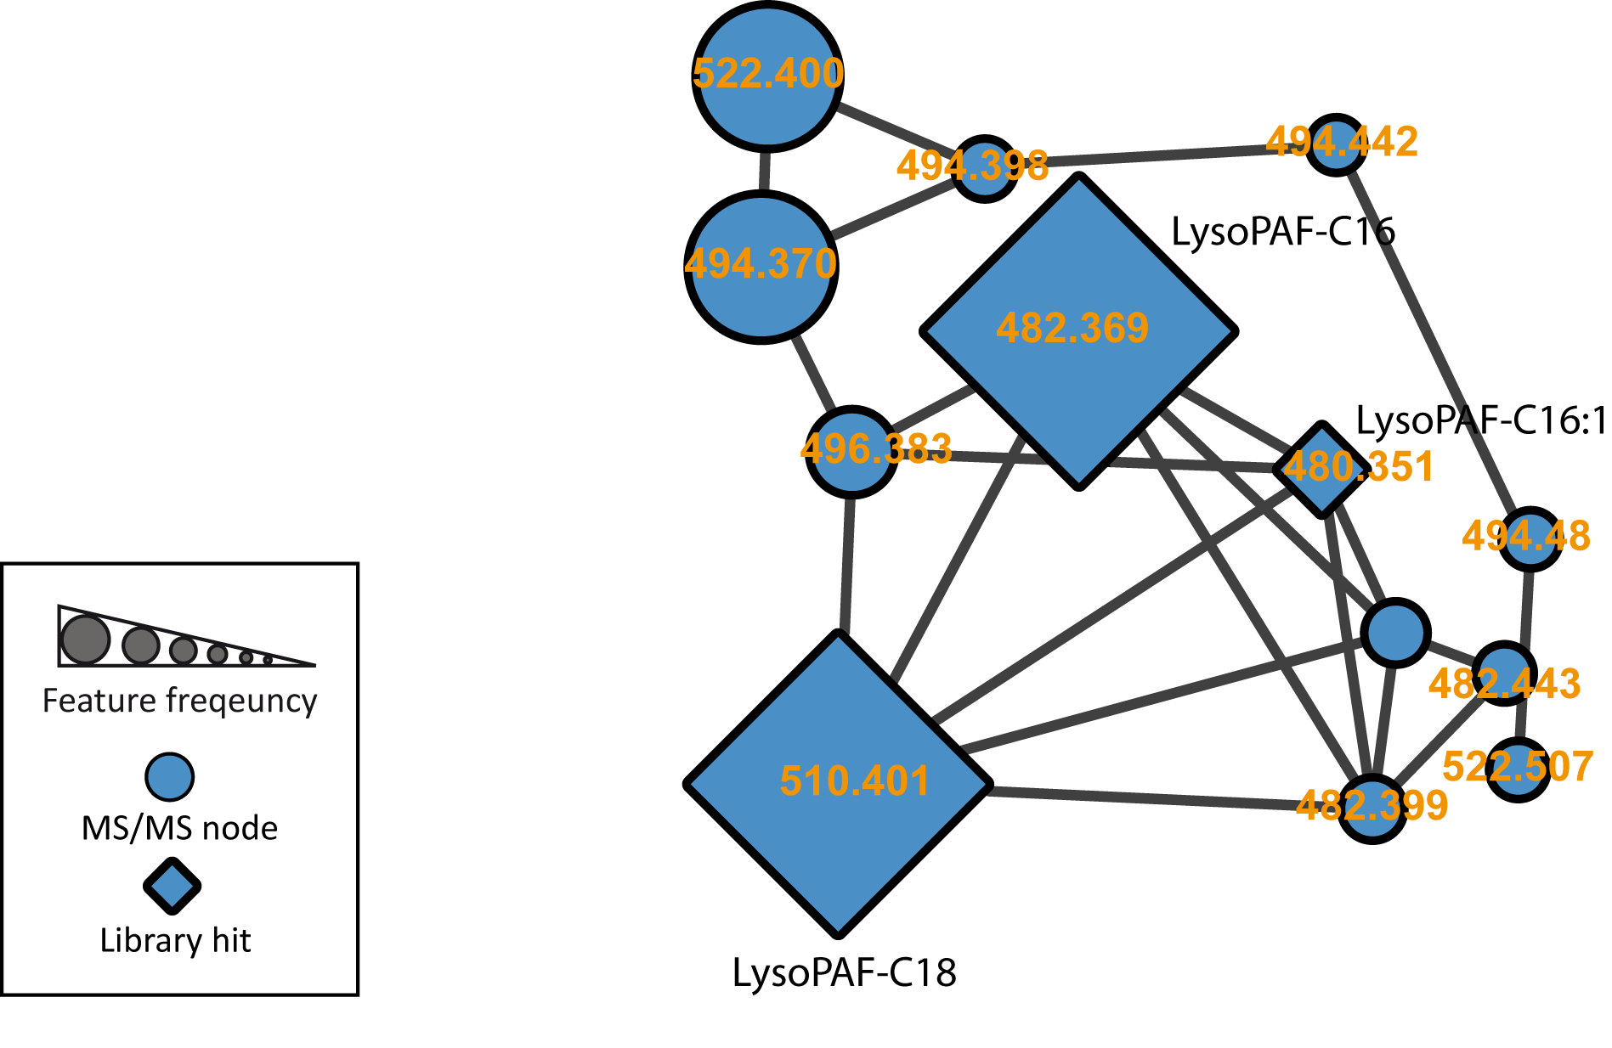
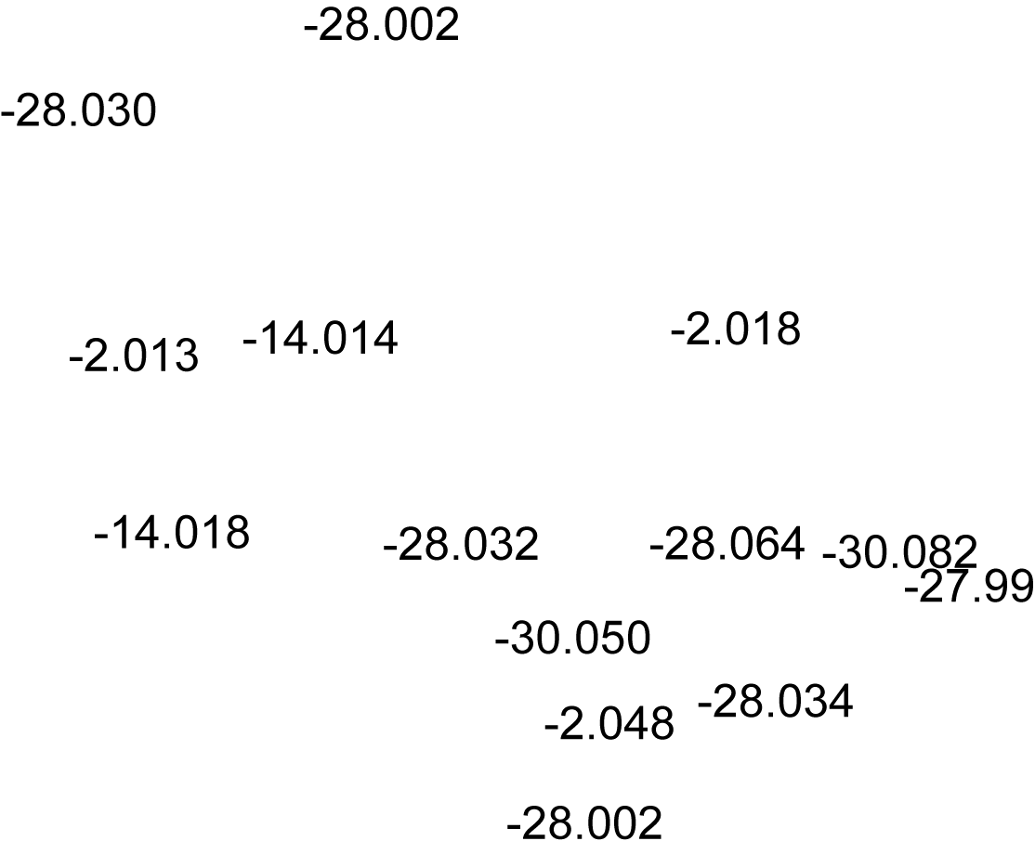
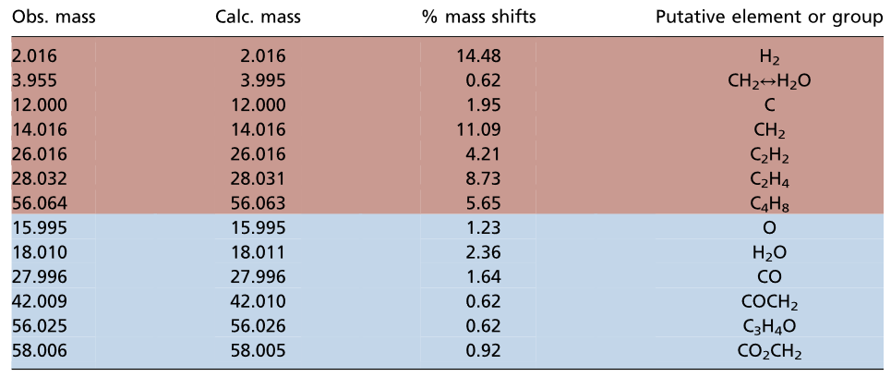
Molecular Network
Hartmann, Petras, Quinn, et al. PNAS, 2017

Slide 4
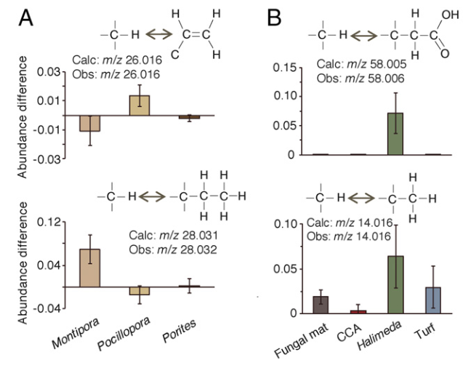
Meta-Mass-Shift Chemical Profiles
Hartmann, Petras, Quinn, et al. PNAS, 2017

Slide 5
Meta-Mass-Shift Chemical Profiles
Static View
Dynamic View
Hartmann, Petras, Quinn, et al. PNAS, 2017

Slide 6
Meta-Mass-Shift Chemical Profiles
Dynamic View
Hartmann, Petras, Quinn, et al. PNAS, 2017

Slide 7
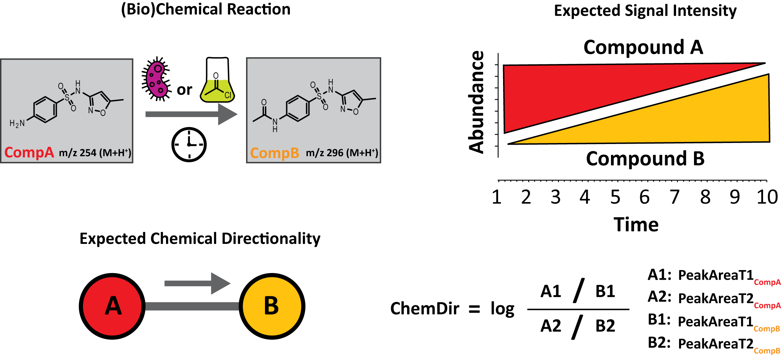
Chemical Directionality (ChemDir)
Petras, Caraballo, Jarmusch, et al. on bioRxiv soon

Slide 8
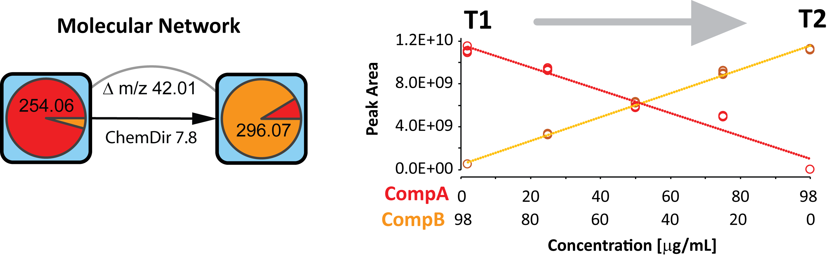
Chemical Directionality (ChemDir)
Petras, Caraballo, Jarmusch, et al. on bioRxiv soon

Slide 9
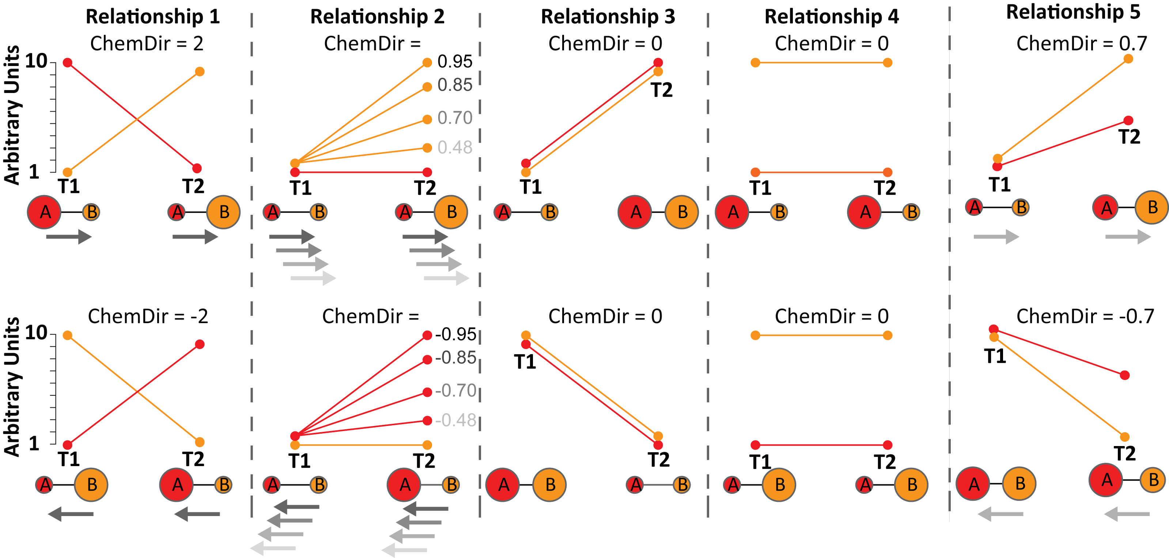
Chemical Directionality (ChemDir)
Petras, Caraballo, Jarmusch, et al. on bioRxiv soon

Slide 10
Chemical Directionality (ChemDir)
Petras, Caraballo, Jarmusch, et al. on bioRxiv soon

Slide 11
Chemical Directionality (ChemDir)
Petras, Caraballo, Jarmusch, et al. on bioRxiv soon

Slide 12
Chemical Directionality (ChemDir)
Petras, Caraballo, Jarmusch, et al. on bioRxiv soon

Slide 13
Chemical Directionality (ChemDir)
Petras, Caraballo, Jarmusch, et al. on bioRxiv soon

Slide 14
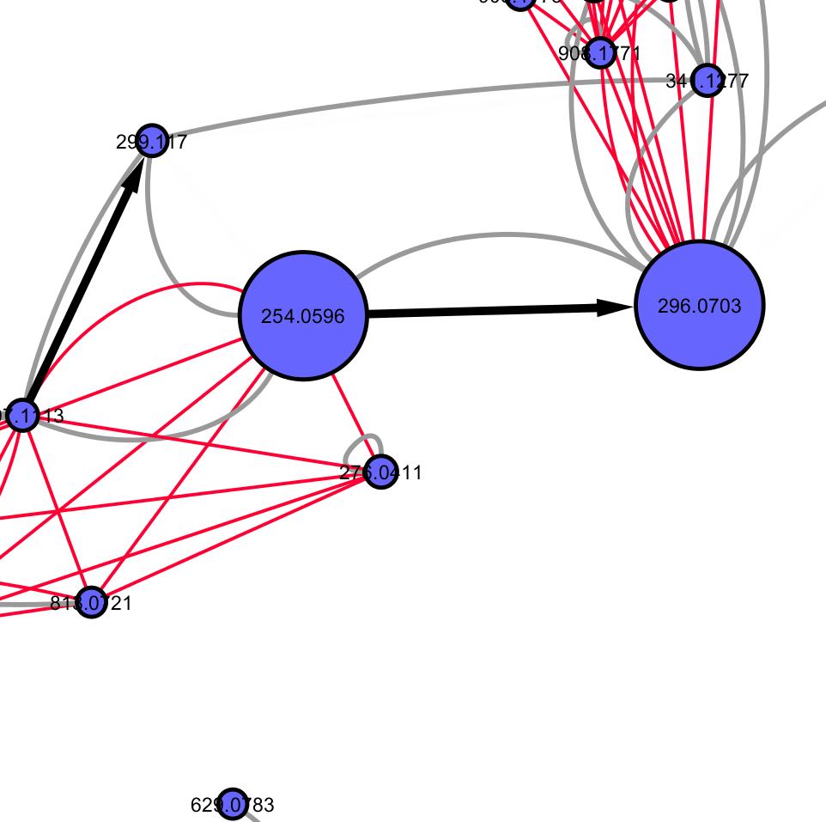
Chemical Directionality (ChemDir)
CLUSTERID1 | CLUSTERID2 | Cosine | DeltaMZ | max_chemdir | max_comparison | sign_chemdir
1 | 321 | 0.86 | -42.0110 | 4.96 | ChemDir_G1:ChemDir_G4 | -1
1 | 3 | 0.95 | -253.0520 | 0.17 | ChemDir_G1:ChemDir_G4 | 1
1 | 5 | 0.93 | -45.0570 | 0.12 | ChemDir_G1:ChemDir_G4 | -1
3 | 15 | 0.78 | -306.9680 | 0.30 | ChemDir_G1:ChemDir_G4 | -1
3 | 16 | 0.77 | -306.9690 | 0.03 | ChemDir_G1:ChemDir_G4 | 1
3 | 5 | 1.00 | 207.9940 | 0.29 | ChemDir_G1:ChemDir_G4 | -1
5 | 327 | 0.91 | -42.0110 | 5.15 | ChemDir_G1:ChemDir_G4 | -1
6 | 11 | 0.96 | -253.0520 | 0.03 | ChemDir_G1:ChemDir_G4 | -1
6 | 20 | 0.80 | 235.0430 | 1.09 | ChemDir_G1:ChemDir_G4 | 1
6 | 219 | 0.95 | -253.0530 | 0.38 | ChemDir_G1:ChemDir_G4 | -1
6 | 224 | 0.94 | 212.0280 | 0.38 | ChemDir_G1:ChemDir_G4 | -1
6 | 228 | 0.72 | -2.9970 | 0.20 | ChemDir_G1:ChemDir_G4 | -1
6 | 266 | 0.86 | 235.0420 | 0.07 | ChemDir_G1:ChemDir_G4 | -1
6 | 273 | 0.72 | -2.9950 | 0.12 | ChemDir_G1:ChemDir_G4 | -1
6 | 293 | 0.76 | 235.0430 | 0.60 | ChemDir_G1:ChemDir_G4 | 1

Slide 15
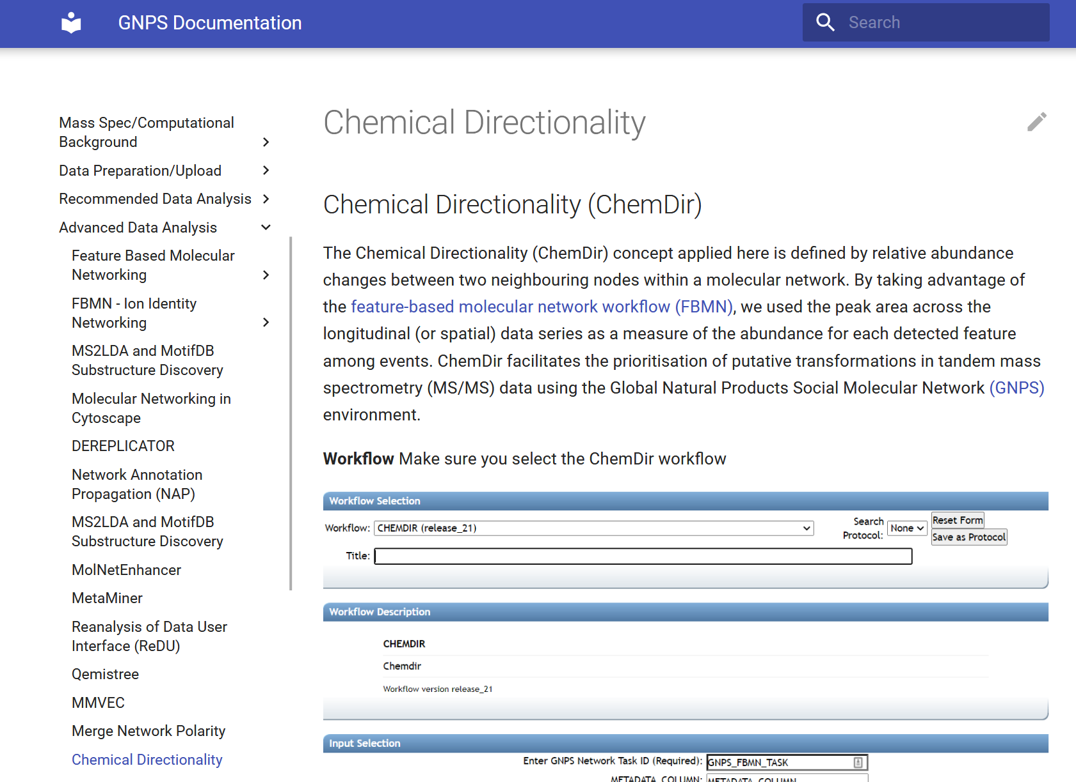
Documentation
https://ccms-ucsd.github.io/GNPSDocumentation/chemdir/

Slide 16
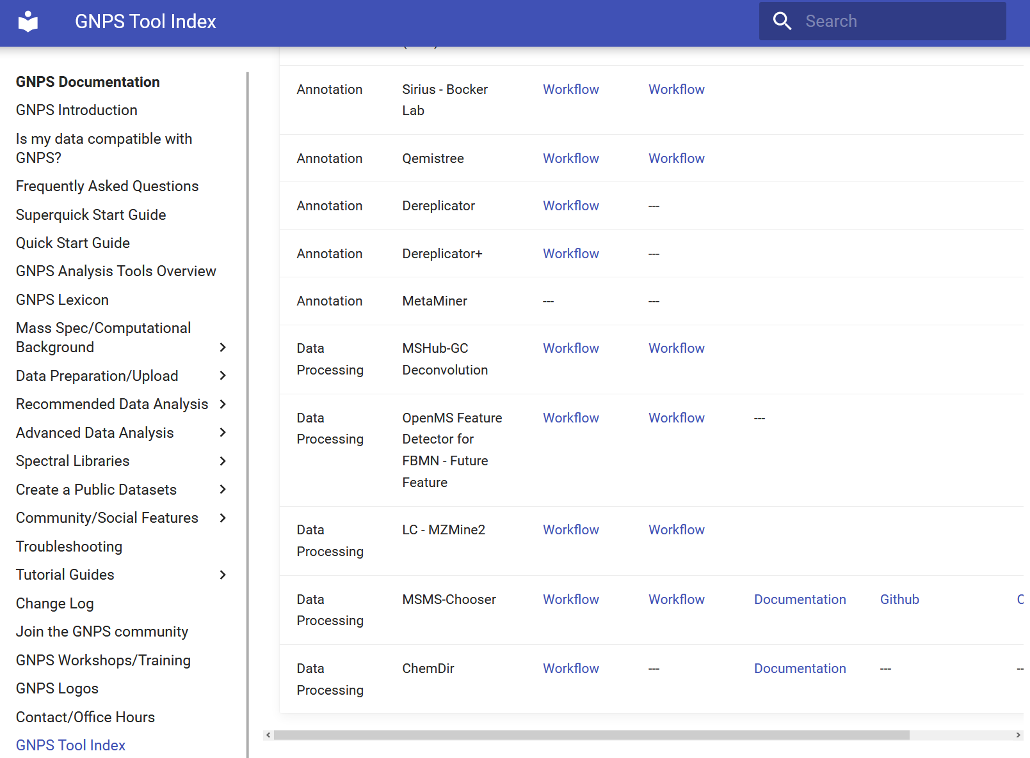
ChemDir Workflow
https://ccms-ucsd.github.io/GNPSDocumentation/toolindex/

Slide 17
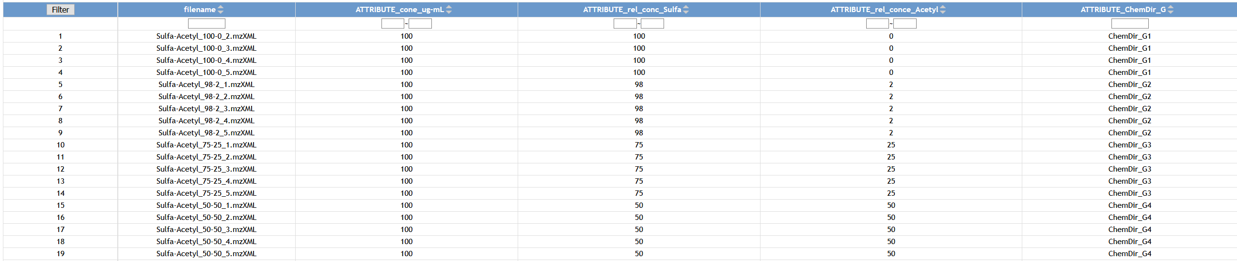
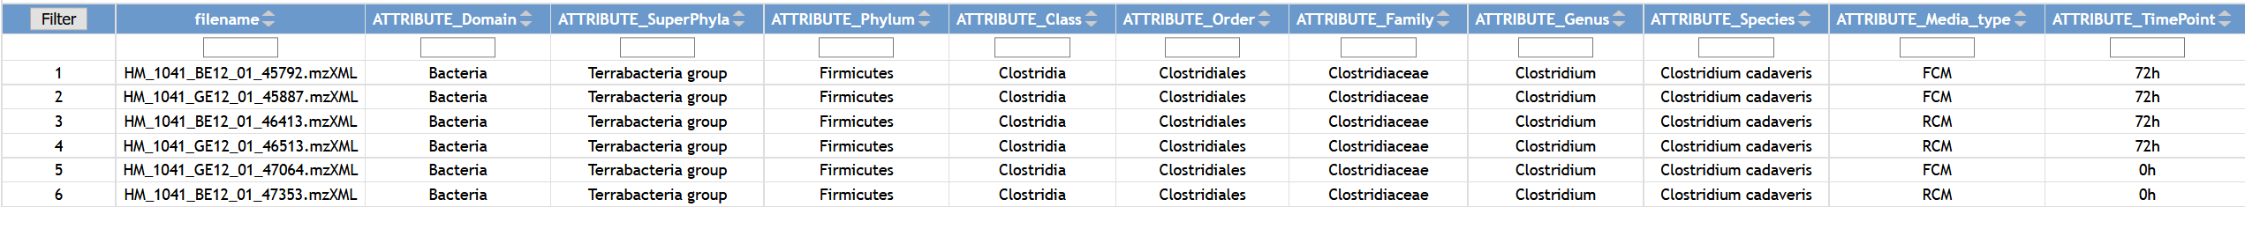
Hands on
1. GNPS FBMN jobs
2. Needs to contain metadata with sequential info (eg. T1,T2,T3,…)
3. ChemDir workflow https://proteomics2.ucsd.edu/ProteoSAFe/index.jsp
A. Ground-Truth example (Acetyl-Sulfamethoxazole)
https://gnps.ucsd.edu/ProteoSAFe/status.jsp?task=2c4b8dfe28884d5396bdcb8a4ccb5f2c
B. Microbial transformation of bile acids
https://gnps.ucsd.edu/ProteoSAFe/status.jsp?task=c4cf7781dbb747e6a0eb4d18656704ae

Slide 18
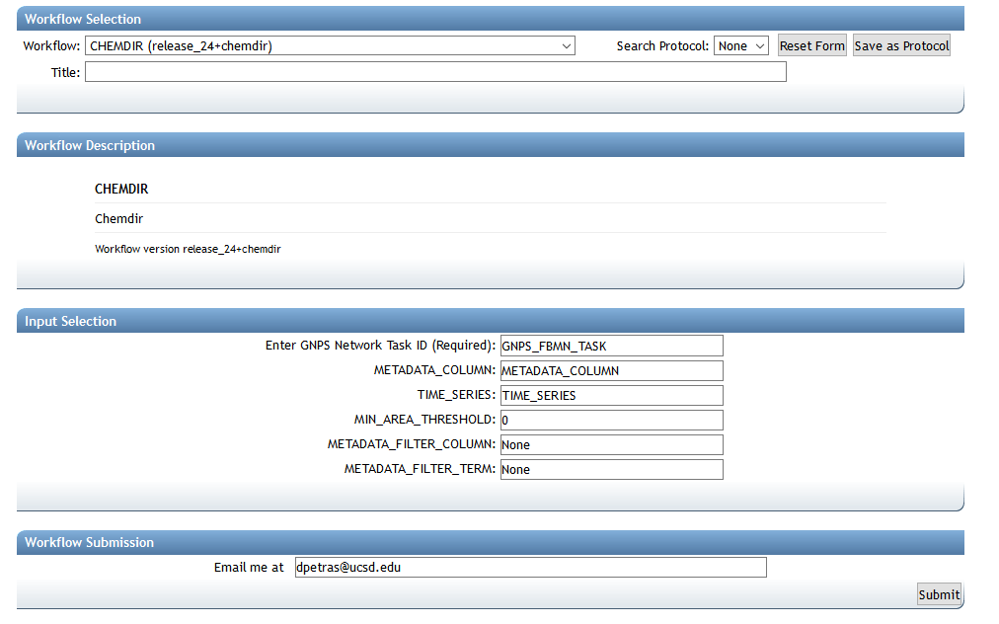
Hands on
Job Name
FBMN Infos
Longitudinal metadata
Threshold
Filter category from metadata
Your email

Slide 19
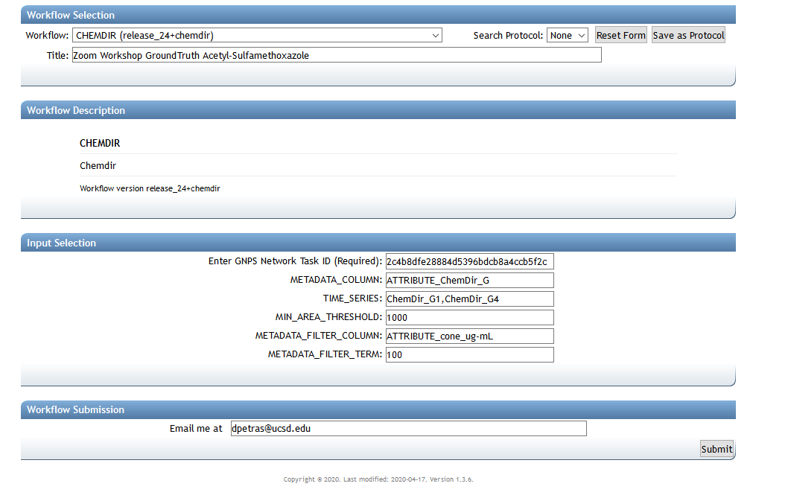
Hands on – A: Acetyl-Sulfamethoxazole
Job Name
FBMN Infos
Longitudinal metadata
Threshold
Filter category from metadata
Your email

Slide 20
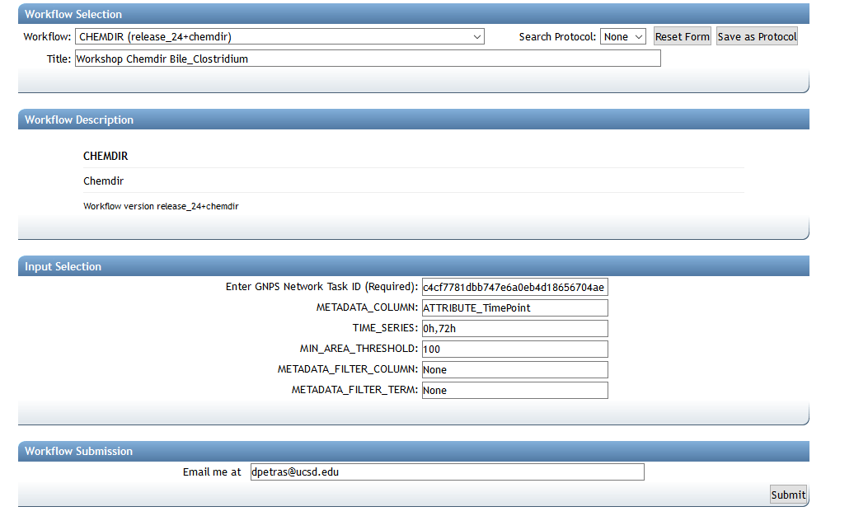
Hands on- B: Bile Acids

Slide 21
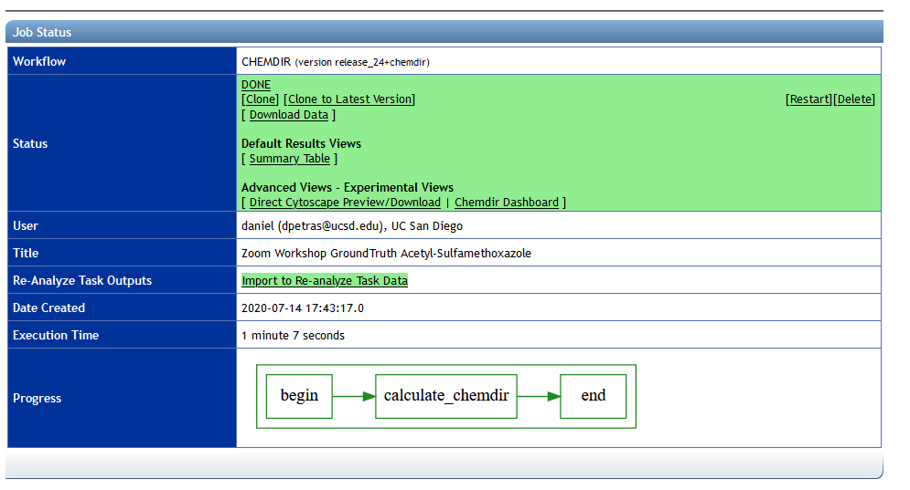
Hands on

Slide 22
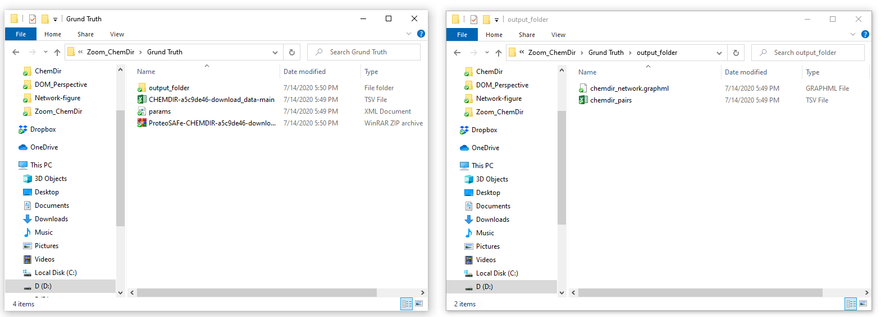
Hands on

Slide 23
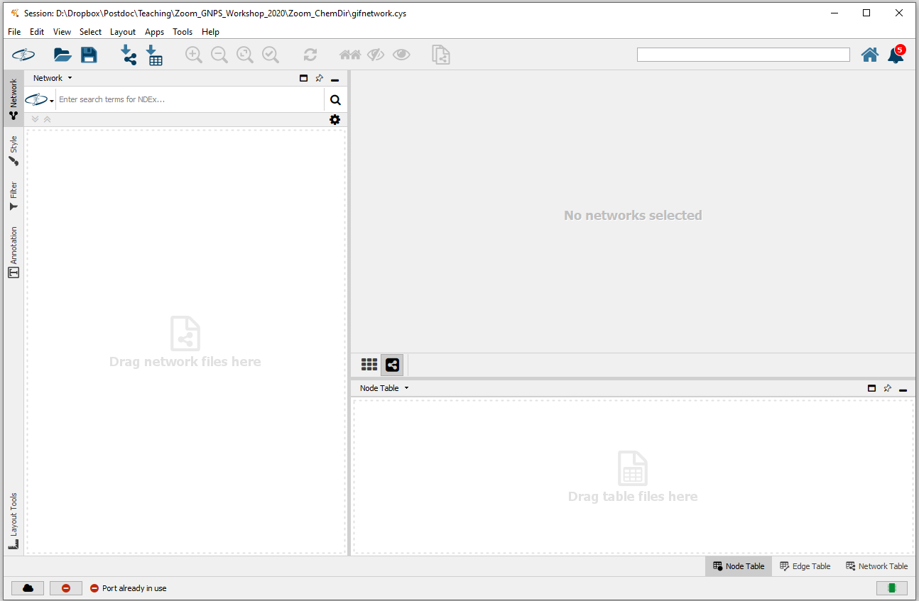
Hands on
Drag and drop chemdir_network.graphml
here

Slide 24
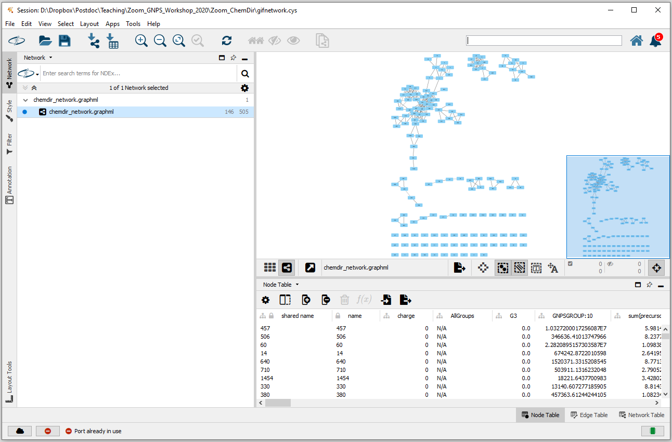
Hands on

Slide 25
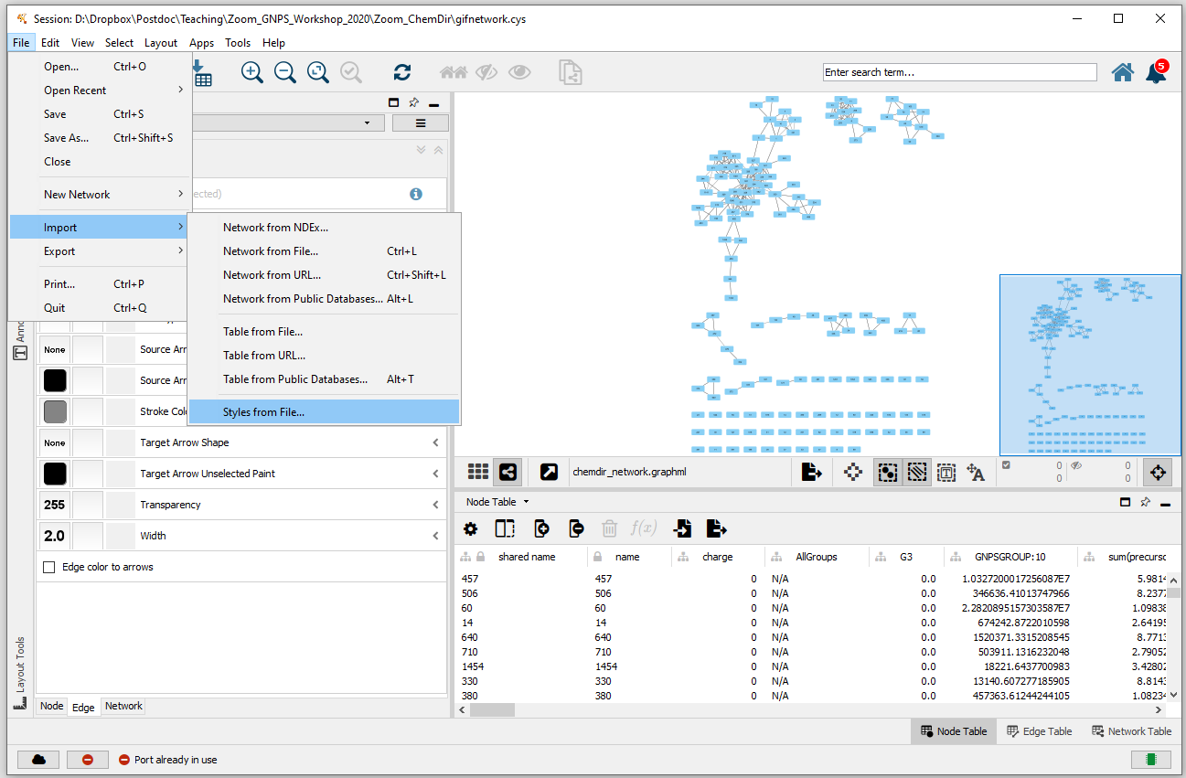
Hands on
Download style from: ftp://massive.ucsd.edu/MSV000085688/

Slide 26
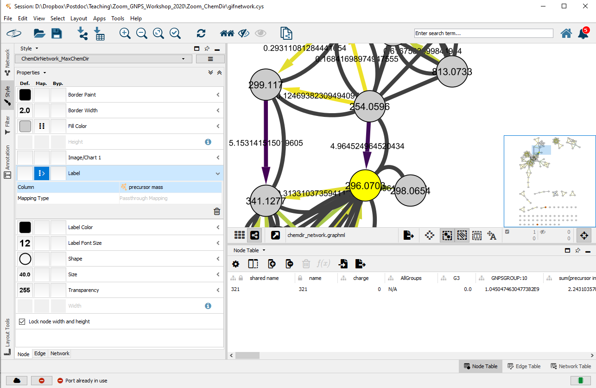
Hands on

Slide 27
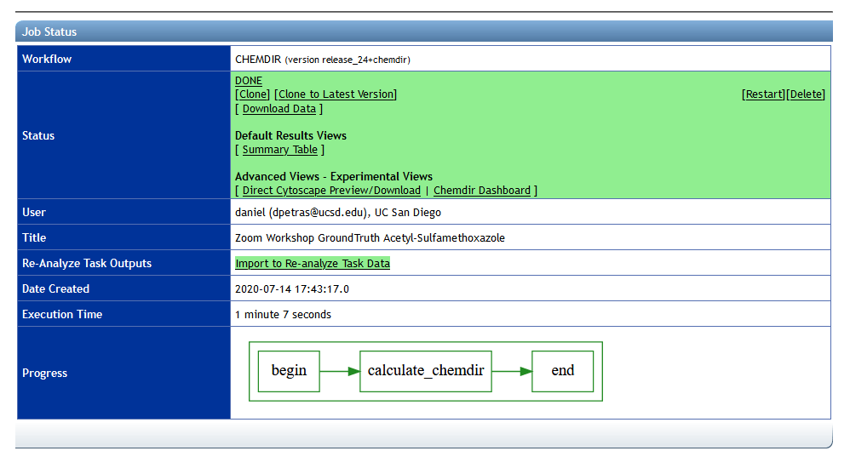
Hands on – ChemDir Dashboard

Slide 28
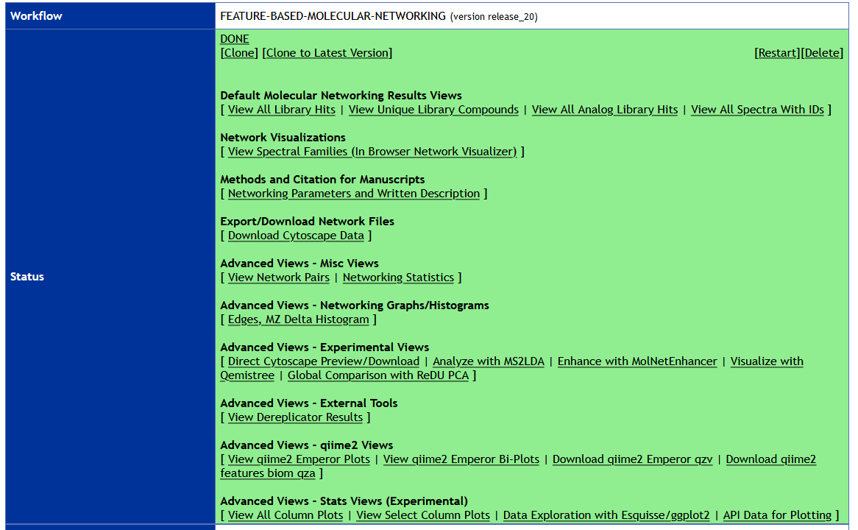
Hands on – Manual validation (FBMN ggplot)

Slide 29
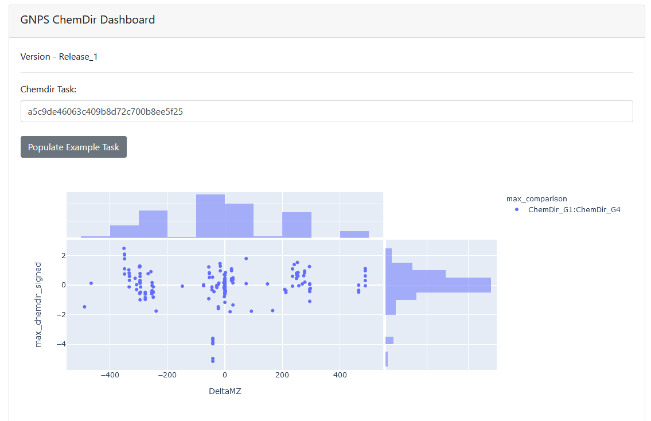
Hands on – ChemDir Dashboard

Slide 30
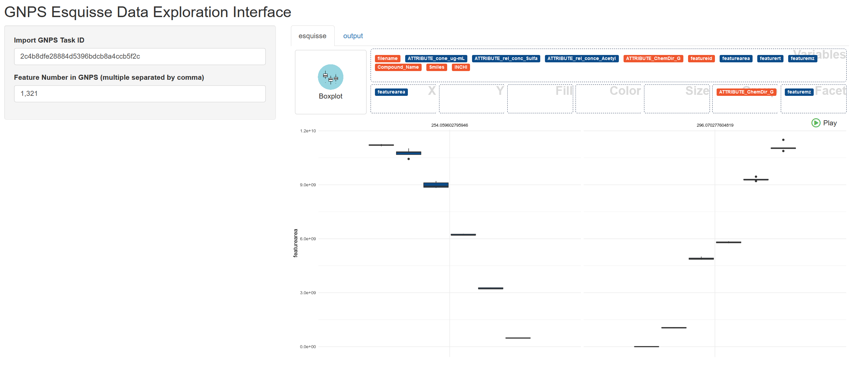
Hands on – Manual validation (FBMN ggplot)

Slide 31
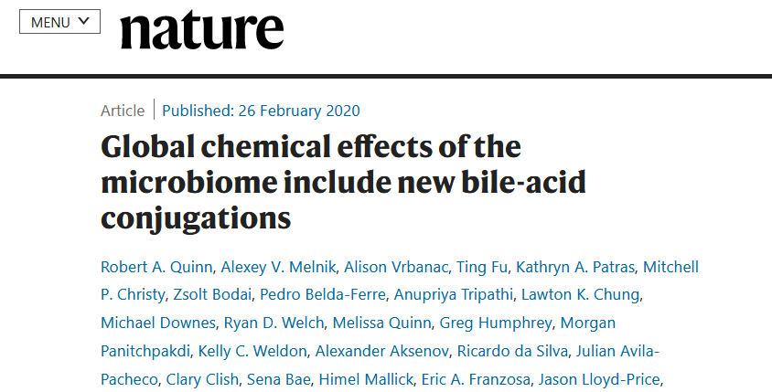
Hands on – ChemDir Backup links
A. Ground-Truth example (Acetyl-Sulfamethoxazole)
https://proteomics2.ucsd.edu/ProteoSAFe/status.jsp?task=a5c9de46063c409b8d72c700b8ee5f25
B. Microbial transformation of bile acids
https://proteomics2.ucsd.edu/ProteoSAFe/status.jsp?task=18eabcb95ee846488db76280f76b8e89
Task: Find microbial derived bile acids

Slide 32
Thank you!
dpetras@ucsd.edu
amcaraballor@ucsd.edu
miw023@cs.ucsd.edu

